Slide 1
Graphic Solar System
By: Vincent Allen Sison & Lizzie Arias

Slide 2
Overview
Created a visualization of the solar system
Used Three JS
Scene
Mesh
GUI
Notes:
Lizzie

Slide 3
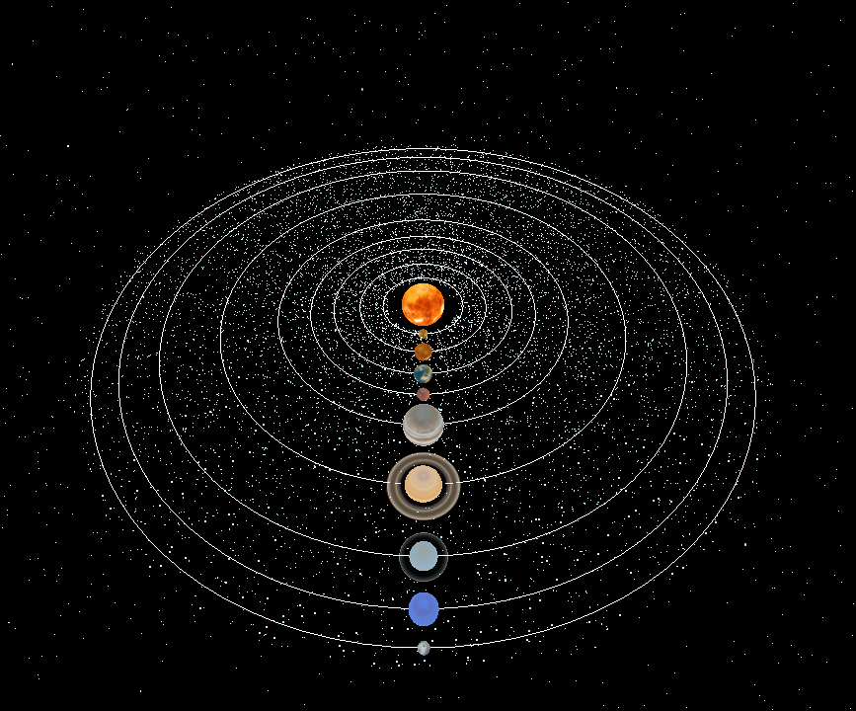
Notes:
Lizzie

Slide 4
Implementation
Notes:
Vincent

Slide 5
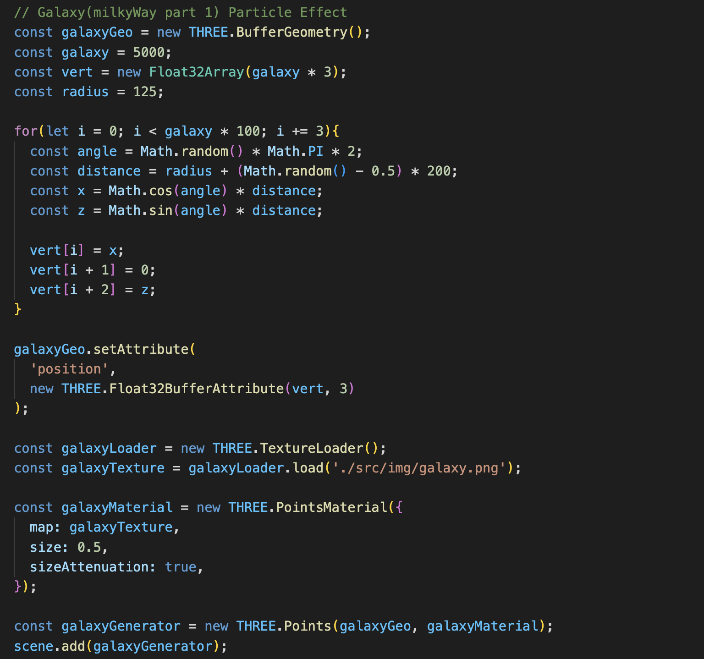
Milkyway Breakdown
Creating the geometry of the particles
Generate random positions for the particles
Setting geometry attributes
Loading textures
Adding it all together
Notes:
Vincent

Slide 6
Process
Notes:
Lizzie

Slide 7
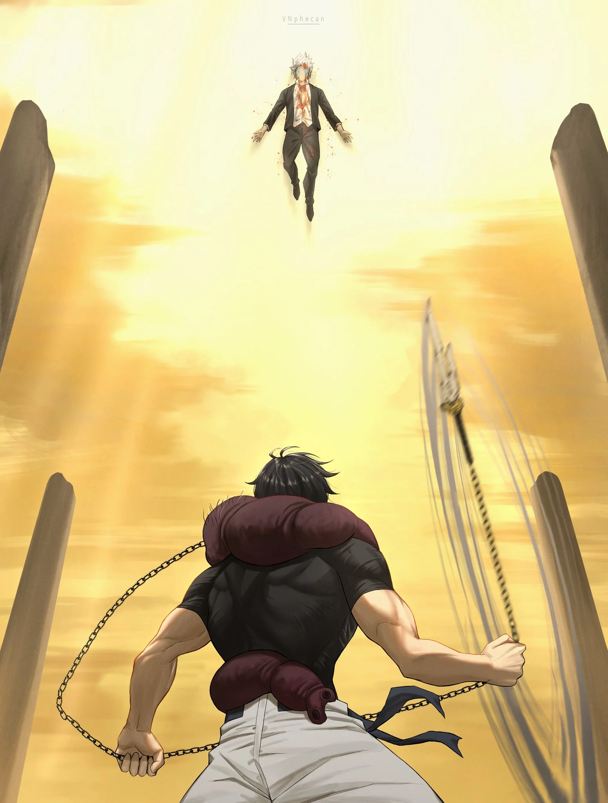
Week 1 - 2
Wasn’t our initial idea
Had a completely different project idea
Wanted to recreate a fight from an Anime (Jujutsu Kaisen)
Planned on using Keyframes and 3D modeling to recreate the fight
KeyFrame: a way to animate an object based on the assumption that the object changes over time
Notes:
Lizzie

Slide 8

Week 3
Scrapped the idea!!
Realized we didn’t have the time to fully recreate the scene
We also didn’t have the experience with 3D models
We de-scoped and tried to think of other ideas we were both interested in
Notes:
Lizzie

Slide 9
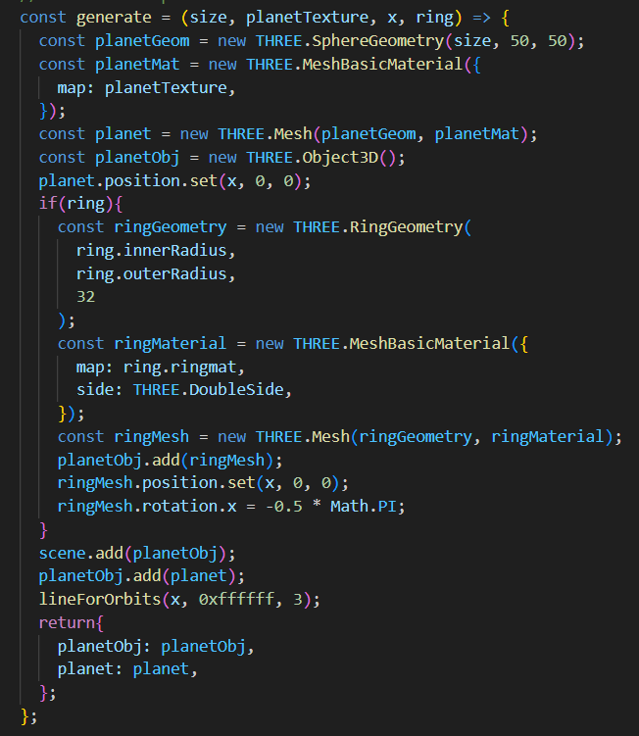
Week 4
Decided to create visualization of the solar system
Late start
Focused on creating the planet models (using THREE JS)
Creating the model
Implementing textures
Making sure the distance between planets was to scale
Create a visualization of each planets orbit
Wanted to animate it so that the planets rotate around the sun
Created a Scene
Made it so that each planet rotate around its own axis and around the sun
Notes:
Vincent

Slide 10
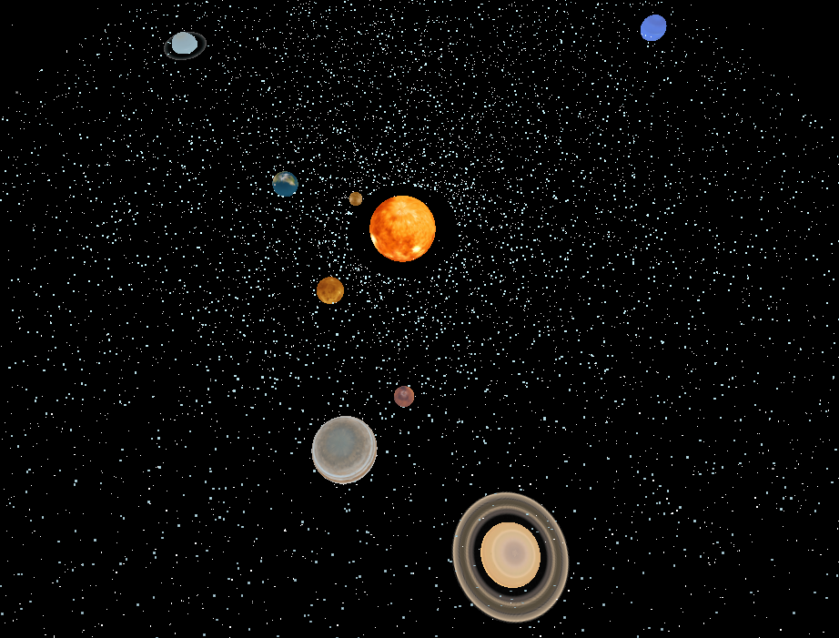
Notes:
Vincent

Slide 11
Week 5
Final Touches
Implemented stars as a background
Implemented a ring of stars around the orbit of the planet
Wanted to make it look like the Milky Way galaxy
Made it so that you can alter the speed of the rotation
Made it so that the orbit visualization can disappear
Notes:
Vincent

Slide 12
Issues
Lacked time
Indecisive and too ambitious
We wanted to use a Particle system to represent the Milky way
Had problem with the lighting
Wanted to implement multiple textures for each planet (mostly the Earth)
Ran into z-fighting
Different Schedules for each member
Notes:
Lizzie Z-fighting is phenomenon that results in flickering, when two or more polygons are on the same coordinate in Z buffer

Slide 13
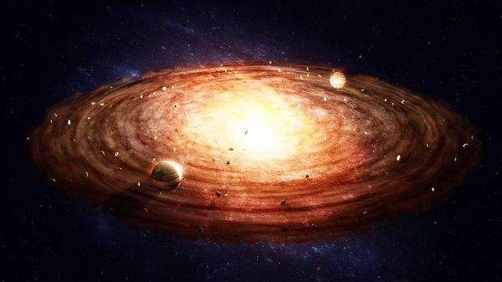
Notes:
Lizzie - inspiration

Slide 14
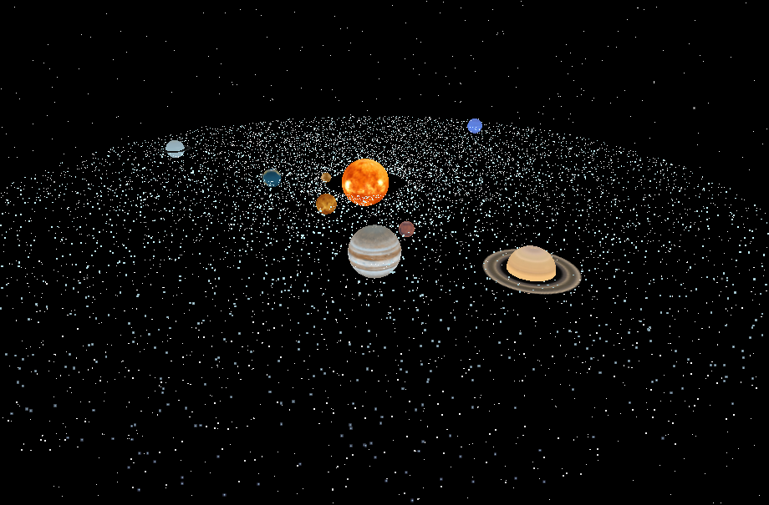
Notes:
Lizzie - final product

Slide 15
Demo
Notes:
Vincent

Slide 16

The End
Any questions?

